Slide 1














Spotify Music Analysis
by Shagun Sharma 211170
Aadya Thakur 211184

Slide 2

Introduction
The aim of this report is to analyse the most streamed Spotify songs of 2023, utilising a comprehensive dataset with various features such as track name, artist information, release details, streaming metrics, and other relevant attributes. The analysis focuses on cleaning the data, identifying relationships between variables, and exploring how track metrics correlate with the number of streams, chart placement, and frequency in playlists.

Slide 3
Data Cleaning
01.
Relationship Identification
Objectives
02.
Visualization and Observations
03.

Slide 4


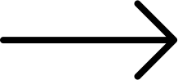


SEABORN
NUMPY
libraries used
MATPLOTLIB
PANDAS

Slide 5
DATA PREPROCESSING
01
02
03
04
REMOVING NULL VALUES
CORRECTING INCORRECT DATA TYPES
CONVERTING TO PITCH CLASS NOTATION
ADDING NEW COLUMNS

Slide 6
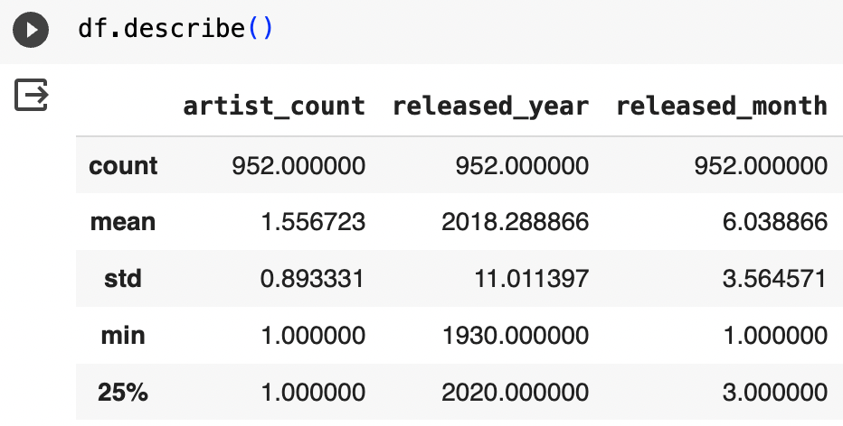
DESCRIPTIVE SATISTICS
Following observations were made using descriptive statistics :-
The dataset spans from songs released in 1930 to the latest releases in 2023
The number of streams ranges from a minimum of 2,762 to a maximum of 3,703,895,000.
BPM (Beats per Minute) ranges from a minimum of 65 to a maximum of 206, with a mean of 122.55.
Valence (Positivity) ranges from a minimum of 4% to a maximum of 97%, with a mean of 51.41%.
Danceability ranges from a minimum of 23% to a maximum of 96%, with a mean of 66.98%.

Slide 7
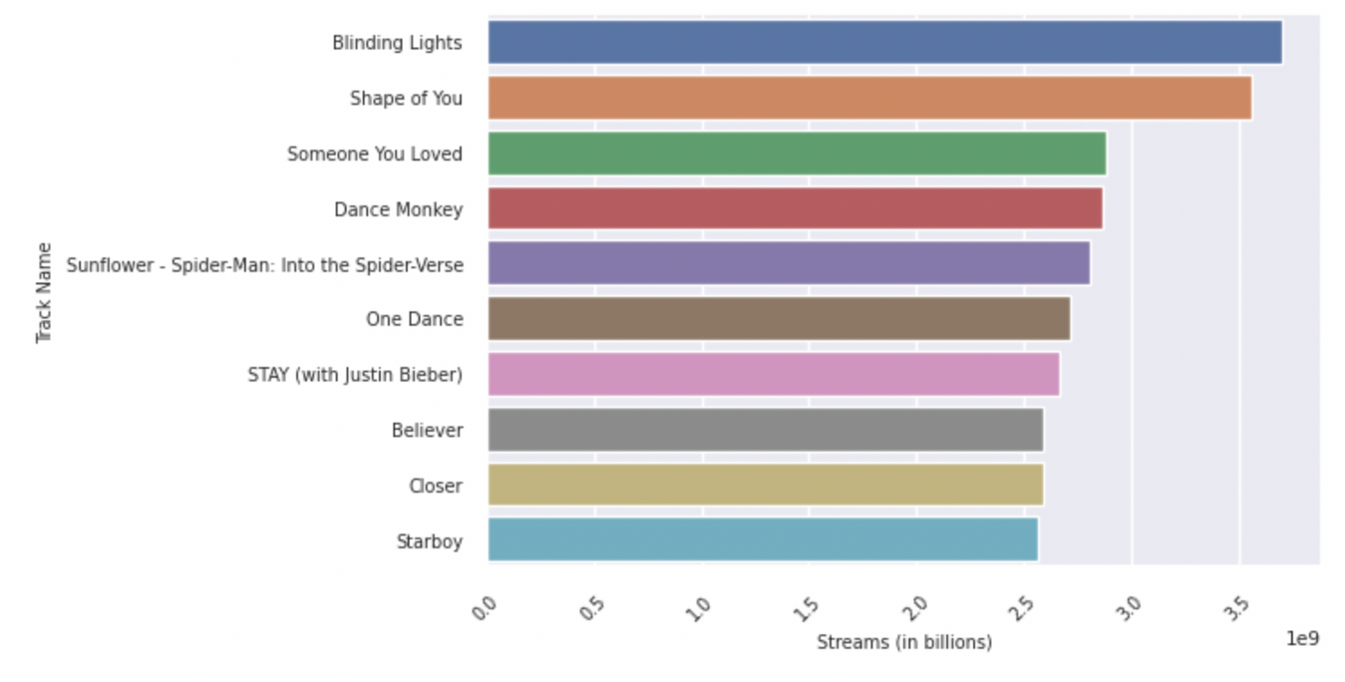
DATA VISUALIZATION
Most streamed songs
Using various data techniques we visualized our data into barchart, histograms, graphs and correlation matrix to show the relationship between various metrics and how the impact the number of streams.

Slide 8
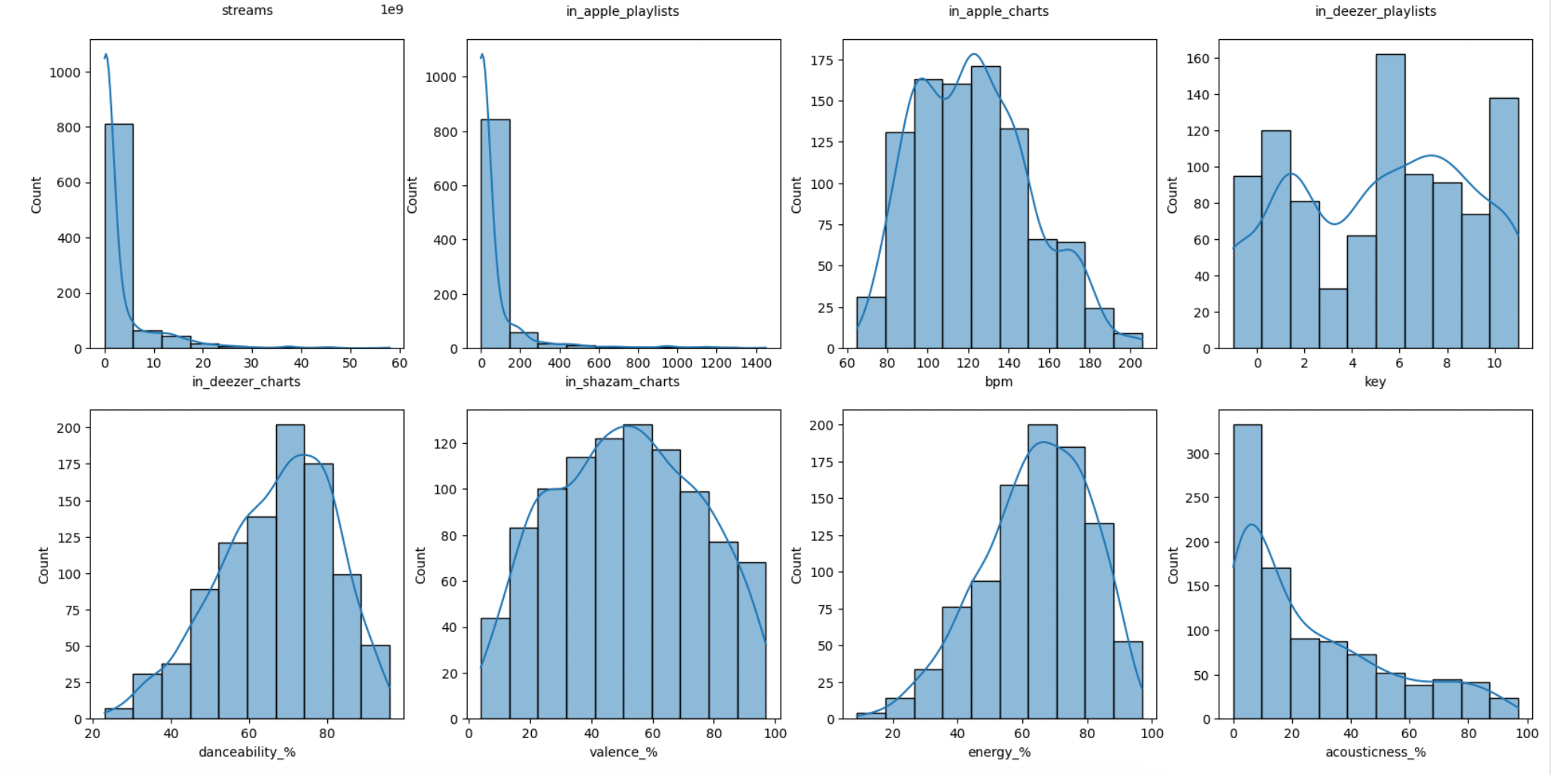

Slide 9
OBSERVATIONS

Slide 10
OBSERVATIONS
Most top-streamed tracks did not place in charts, and they exhibit shorter streaming durations compared to charting tracks. This is often indicative of newer tracks that haven't charted yet but are streamed heavily.
A significant number of top-streamed tracks are not present in many playlists across different platforms. This could be attributed to their recent release, indicating that tracks are streamed heavily even before being added to playlists.
Top-streamed tracks include a variety of moods but generally consist of upbeat songs. Listeners prefer tracks with more singing than speech, acoustic elements, and instrumentals.
The release date significantly influences a track's total streaming time, with recently released tracks accumulating more streaming time compared to older tracks.
The track's BPM and key appear to be less influential factors in determining a track's total streaming time.
The dataset lacks highly correlated variables, suggesting that the provided variables alone may not be sufficient to predict a track's streaming success. Further analysis with additional historical records may reveal stronger correlations.

Slide 11
Thank you very much!
www.reallygreatsite.com

